Slide 1

Business leader meeting slides
Introducing the Decision-Making Framework to your team
LAST UPDATED: FEBRUARY 2024

Slide 2
Contents
The Decision-Making Framework
03
Case studies
09
1. Telemedicine Innovative opportunities
12
2. Market Development Innovative opportunities
16
3. Industry Associations Hiring with integrity
20
4. Artificial intelligence Innovating ethically
24
Key takeaways
28
This Business leader meeting slides are paired with a Facilitation Guide, which provides talking points and instructions for creating an interactive meeting experience. All Decision-Making Framework materials are available on the IFPMA website.

Slide 3

The Decision-Making Framework
Guiding the decision-making flow

Slide 4
Why use the IFPMA Decision-Making Framework?
In an increasingly complex and ever-changing environment, the path forward is not always clear.
The IFPMA Decision-Making Framework:
Enables decision-making when faced with complex, ambiguous, or novel circumstances or ethical dilemmas
Enhances and supports proactive risk management
Integrates compliance with ethical considerations
Encourages ongoing business engagement and accountability
Fosters a culture of integrity and ethical decision-making
Decision-making that integrates compliance, integrity, and ethical considerations into day-to-day business activities bolsters patient and public trust, which are essential for innovation and critical to partnerships and interactions with patients, HCPs, HCOs, third parties, peer companies, the industry, and society.

Slide 5
A framework for developing innovative models
A framework designed to support our evolving industry.
Advancing innovation using an agile approach
Fostering patient-centricity
Ethics-based

Slide 6
Why is the Decision-Making Framework important?
Five steps to navigate decision-making flow to balance patient needs and expectations of the medical community, society, and regulators with business objectives.
1. Why?
2. Who?
3. What?
4. How?
5. Impact
Identify and evaluate
Define accountability and responsibility
Determine and decide
Execute and implement
Monitor and control
This Decision-Making Framework is principles-based and enables leaders to:
Assess new and innovative business models
Ensure decisions are grounded in ethics and integrity to bolster and sustain patient and public trust, which are essential for innovation and critical to partnerships and interactions with patients, healthcare professionals (HCPs), healthcare organizations (HCOs), third parties, peer companies, the industry, and society
Ensure we embed the IFPMA Data and AI ethics principles and act in alignment with the IFPMA Ethos.
IFPMA Ethos

Slide 7
Ethos in action guiding questions
Integrating Ethos into decision-making
C1: How do we play our part in helping solve societal challenges?
C2: How do we ensure patients are first in everything we do (e.g., safety, quality, well-being, innovative solutions)?
C3: In which ways do we adhere to the highest possible scientific and ethical standards from discovery to delivery of our products?
C4: To what extent do we act with integrity in applying scientific medical principles demonstrating the safety and efficacy of our products?
C5: How do we ensure that we move “as fast as we can, but as slow as we must”?
F1: How do we act with integrity to earn the trust of patients, healthcare providers, other stakeholders and the society we serve?
F2: How do we ensure that we do what is right, even when no one is watching?
F3: Through what measures do we hold ourselves and our partners accountable?
F4: How do we properly assess and mitigate all the risks associated with our innovative products/services?
F5: How do we ensure that we treat our third parties, customers and stakeholders fairly?
H1: What measures are we taking to ensure active, timely, balanced, and truthful communication?
H2: How are we ensuring transparency throughout our activities and processes, both internally and externally?
H3: What are the legitimate needs for patients, healthcare providers, ourselves, and society that we intend to meet?
H4: How are we enabling both internal and external stakeholders to speak up and raise potential ethical challenges?
H5: How are we learning from mistakes as well as best practices and communicating these within the organization?
R1: What measures do we take to respect human rights and/or animal rights?
R2: How do we take our environmental impact into account in our actions?
R3: What are we doing to ensure respect for privacy rights?
R4: In what way are we driving scientific advancements to ensure a more educated industry, community, and society?
R5: Through what measures do we ensure and display our appreciation of the value of diversity?

Slide 8
Decision-making flow summary
Phase | Steps
1. Why Identify and evaluate | What is the rationale and purpose for conducting an activity? Are patients first in the decision? Will the activity address patients’ unmet needs? Have we considered their safety and well-being? Will the activity address other stakeholders’ needs (e.g., healthcare professionals)? Is the activity proportionate to the identified needs? Have we identified the risks? Could there be a perception of wrong intent by patients, regulators etc. if we go ahead with the activity? Is the timing right for this activity (e.g., use of the data and/or a new technology)? What are the issues or challenges to be addressed? Do we have all the information we need? Have we assessed potential impact on stakeholders and identified data sources contributing to this assessment?
2. Who Define accountability and responsibility | Who is the decision-maker? Who is the owner of the activity? If cross-functional, what are the other departments involved (in addition to the department of the owner) and what are their roles and responsibilities in the project? When using new technology, how do we ensure we maintain human accountability and build in monitoring and feedback loops? What are the capabilities required by the individuals/teams who will assess, monitor risks, and implement the solution?
3. What Determine and decide | Have we considered the option of NO GO (not moving forward with the proposal)? What are the potential options and solutions proposed to meet the needs or to resolve the problem? What type of activity will best satisfy the rationale and purpose identified? Would we be comfortable to discuss the activity with our family, or the public? Are all stakeholders informed and empowered to speak up and raise any potential challenge? Did we minimize risk and conclude that potential benefits exceed potential risks? Did we value diversity and distribute risk and benefit fairly? What are the key elements to take into consideration in conjunction with IFPMA Ethos? Explain the business decision-making principles that we are going to apply and consider the dilemmas, if any.
4. How Execute and implement | Is the solution compliant with applicable laws and regulations and with the organization’s policies? Is the action fair, the “right” thing to do? Consider the public perception if made public. What are the detailed action plans, timelines, deliverables for each team member at each stage of the project (before, during, and after)? What are the available feedback mechanisms to stakeholders and the end-users and how do we propose to handle the feedback? What are the total and detailed costs and payment terms based on deliverables?
5. Impact Monitor and control | What are the key success factors of the project? Have we planned to notify / report to appropriate persons (open and transparent communication, disclosure of potential issues)? Have we aligned measurements (KPIs) with objectives and deliverables? Ensure an appropriate owner of these factors/KPIs is assigned. Set up reporting and financial controls on costs and monitor the effects of decisions/project, adjust actions to new information as necessary.

Slide 9

Case studies
Putting decision-making to work

Slide 10
Putting decision-making to work
Case study exercise
How to use the case studies?
The case studies are intended to facilitate cross-functional discussion. You do not need to solve the case. Use the Decision-Making Framework to discuss the impact of the different scenarios.
The purpose of the case studies is to use IFPMA Decision-Making Framework to identify and discuss complex, innovative, or “grey areas” and develop proposals that balance competing needs and obligations and ensure our decisions are consistent with the IFPMA Ethos.
Adaptation and localization
The case studies provided are general fictious examples for the purpose of discussion only. Local adaptation of the facts of each case study scenario might be needed to suit local market conditions and to ensure adherence to local laws, regulations, and industry codes.
Use slides 14 – 18 of the Background deck to guide the approach
Disclaimer: These case studies are purely fictious examples for the purposes of discussion. IFPMA does not endorse any of the views or scenarios in these case studies.
All related compliance guidance should always be subject to applicable local laws, regulations, and industry codes.

Slide 11




Case study summaries
Case study 1
Case study 2
Case study 3
Case study 4
Telemedicine
Innovative opportunities
New, innovative business models and technologies such as telemedicine can present significant opportunities as well as new dilemmas related to appropriate HCP interactions.
Market development
Innovative opportunities
Entering a new therapy for a chronic disease and expanding an existing one presents a lot of new business opportunities but also gives rise to new challenges related to interactions with HCP, HCOs, and patients.
Industry associations
Hiring with integrity
Some association activities, such as hiring for policy-related positions, can pose significant risks that need to be mitigated, including potential conflicts of interest and reputational harm.
Artificial intelligence
Innovating ethically
Entering the realm of artificial intelligence (AI) entails navigating the landscape of AI-related risks and harms. To mitigate them, it is crucial to adopt a decision-making framework that embeds ethics and integrity.

Slide 12
Telemedicine Innovative opportunities
Case study 1

Slide 13
1. Background
Case study 1
Telemedicine Innovative opportunities
To pursue growth opportunities outside of the traditional pharmaceuticals space, your company is looking into a potential role in telemedicine. Telemedicine is a rapidly growing opportunity driven by changes in technology and patient and provider preferences.
In assessing this opportunity, your team is investigating potential business model options. One option currently being discussed involves the following:
Your company would provide selected HCPs with hardware (iPads) and software (free licenses to telemedicine video conferencing software) in exchange for collecting blinded patient diagnosis and prescription data through the platform.
Your company would also provide these HCPs with company-developed software that assists HCPs with diagnosis and treatment decision-making. The software uses AI to analyze the video, audio, and HCP notes from the telemedicine visit and recommends potential diagnoses and treatment options. While the software is designed to provide unbiased recommendations, its AI was trained in part with proprietary company data.

Slide 14
2. Considerations
Case study 1
Telemedicine Innovative opportunities
There are few guidelines or regulations in this space, and competitors have not yet adopted similar approaches. Your team should assess and balance the commercial and ethical considerations prior to making a formal recommendation to leadership.
Consider how your answers and reflections would change in the following circumstances:
What if different stakeholders are potentially provided hardware/software to support the telemedicine, for example, patients, HCPs, hospitals, medical practices, and other providers? Does this impact the decisions or risk management?
Local legal/regulatory considerations may impact the decision or local industry guidance exists on telemedicine that may impact the preferred approach (including potential near-term changes or regulations). What legal changes or advocacy may be needed for the group’s approach to be viable (e.g., industry, company, digital, stakeholder engagement)?
Are there different implications due to the country medical insurance/reimbursement system (e.g., public, private)?

Slide 15
3. Applying the Decision-Making Framework
Case study 1
Telemedicine Innovative opportunities
A non-exhaustive list of questions to support decision-making:
1. Why Identify and evaluate | What are the legitimate business needs and the business objectives you are trying to achieve? Are we respecting patients and protecting their privacy rights? Was the IA algorithm designed ethically, avoiding biases and without creating any potential discrimination? Was patient safety top of mind? How would the society perceive these initiatives? Do these initiatives help to build trust with the society?
2. Who Define accountability and responsibility | Discuss various roles and responsibilities. If cross-functional, which department owns which activity?
3. What Determine and decide | What are the key ethical and risk management areas for consideration and related mitigation actions? If several options could be considered, what decision will best satisfy the rationale and purpose identified and reflect business decision-making? Are there other external developments on the horizon that may impact the decision and should be considered?
4. How Execute and implement | What are the existing laws and codes to be considered? In light of applicable laws, codes, and industry guidelines, is the initiative permitted? Is it appropriate to provide these benefits to individual HCPs? Is the execution and implementation strategy sustainable?
5. Impact Monitor and control | Describe what the key success factors would look like. Are measurements (KPIs) aligned with objectives and deliverables? How would these success factors be viewed by stakeholders? Are there significant financial controls required and what are the costs to support effective controls (e.g., monitor the effects of decisions/project?)

Slide 16
Market development Innovative opportunities
Case study 2

Slide 17
1. Background
Case study 2
Market development Innovative opportunities
Your company is entering a new therapy for a chronic disease where there have previously been no treatment options available. This means that the market will need to be developed to increase patient awareness of the disease and to train healthcare professionals in providing quality of care with the new treatment option your company has developed that is currently in phase 3 of clinics trials.
Your team is investigating potential development strategy and tactics for this area. The options currently being discussed include:
Your company would run company driven medical education events for the top disease specialists. Attendees would be invited to discuss the phase 3 results of your company’s clinical trials. The new treatment option is not yet approved but there are no competitors in this therapy area and the results are so good, your team is sure it will be approved soon so why wait!
Your local affiliates will work with local patient associations to run a social media campaign for patients on disease awareness. As part of this campaign, you will highlight that a new treatment option is on the way, and that patients should ask their doctor about it.
As part of the social media disease awareness campaign, patients will be asked to share their personal experiences of living with the disease in a Facebook group. Your team will use these testimonials as part of the brand campaign to make sure they take into account the patient experience.

Slide 18
2. Considerations
Case study 2
Market development Innovative opportunities
You should assess and balance the commercial and ethical considerations prior to making a formal recommendation to leadership about the suggested development strategy and tactics.
Consider how your answers and reflections would change in the following circumstances:
What if a competitor entered the therapy area with a new but unapproved product?
What if a competitor product was already approved and available?
What difference would it make (if any) if other treatment options existed?
What if the company decides to run the disease awareness campaign by itself - are there other things you will need to take into account?
What if your company’s new treatment option (which is the only one available) is approved but not available via the public healthcare systems or public reimbursement lists? What additional elements do you need to think about?
Would you use social media as a tool in disease awareness in the same way if the chronic disease only affected adolescents? Or children?

Slide 19
3. Applying the Decision-Making Framework
Case study 2
Market development Innovative opportunities
A non-exhaustive list of questions to support decision-making:
1. Why Identify and evaluate | What are the legitimate business needs and the business objectives we are trying to achieve? Could these initiatives be or be perceived as pre-approval promotion/promotion to the public? Are you respecting patients and their disease? Is it ethical to make patients aware of a treatment option knowing that it might only be available on the private market? Is it responsible to use social media to conduct disease awareness activities towards children and adolescents? What are the implications of using patient testimonials in brand campaigns? Does the answer change if the patients are children? How do you approach issues of affordability and patient access in these circumstances? How would the society perceive these initiatives?
2. Who Define accountability and responsibility | Discuss various roles and responsibilities. If cross-functional, which department owns which activity? What is the appropriate function to run these activities based on roles and responsibilities (medical versus commercial)?
3. What Determine and decide | What are the key ethical and risk management areas for consideration and related mitigation actions? If several options could be considered, what decision will best satisfy the rationale and purpose identified and reflect business decision-making? Are there other external developments on the horizon that may impact the decision and should be considered?
4. How Execute and implement | What are the existing laws and codes to be considered? In light of applicable laws, codes, and industry guidelines, is the initiative permitted? Is it appropriate to provide these benefits to individual HCPs? Is the execution and implementation strategy sustainable? How do we ensure that we move “as fast as we can, but as slow as we must?”
5. Impact Monitor and control | Describe what the key success factors would look like. Are measurements (KPIs) aligned with objectives and deliverables? How would these success factors be viewed by stakeholders? Are there significant financial controls required and what are the costs to support effective controls (e.g., monitor the effects of decisions/project)?

Slide 20
Industry associations Hiring with integrity
Case study 3

Slide 21
1. Background
Case study 3
Industry associations Hiring with integrity
Your Pharmaceutical Industry Association ("Association") is currently undergoing a hiring process, as there is an open full-time position for the Director of Public Affairs role. As the Executive Director of the Regulatory & Science Committee within the Association, you are part of the election panel.
Multiple applicants were screened, and the hiring process is close to final stage, with the three top candidates going through the defining election panel interviews with the Board Members in about a month.
The Regulatory & Science Committee raises a last-minute recommendation to hire a well-recognized consultant, whose vast professional experience would perfectly fit the needs for the role and who would be ready to start immediately. The candidate currently advises the government on public procurement decisions related to inclusion of new technologies. The Association is invited to an important upcoming public Working Group meeting regarding the dialogue on procurement policies with government authorities and other industry stakeholders. The meeting is critical in advancing the Association's priorities, and the new Director of Public Affairs would play a pivotal role at the meeting, representing the Association.
A recommendation needs to be made to the Board Members in terms of:
Hiring the candidate recommended by the internal Committee, who would be ready to start immediately.
Continuing with the current selection process and likely not having the position filled until after the meeting.

Slide 22
2. Considerations
Case study 3
Industry associations Hiring with integrity
You should assess and balance the commercial and ethical considerations prior to making a formal recommendation to the Board.
Consider how your answers and reflections would change in the following circumstances:
There is no upcoming meeting requiring the role to be filled immediately.
The recommendation did not come from an internal Committee but instead from a headhunter that is aware of the Association's ongoing hiring process.
A job offer was about to be released to a final candidate.
Are there different implications if the candidate's governmental advisory role is official (i.e., is formally appointed) or unofficial (i.e., not formally appointed but consulted due to publicly known key expertise)?
Are there different implications if the candidate's governmental advisory role is not related at all to the upcoming meeting topic and objectives?

Slide 23
3. Applying the Decision-Making Framework
Case study 3
Industry associations Hiring with integrity
A non-exhaustive list of questions to support decision-making:
1. Why Identify and evaluate | What are the legitimate business needs and the business objectives you are trying to achieve? Do you have all the information you need to make a decision? How might hiring the consultant recommended by the Regulatory and Science Committee benefit the Association? How might hiring the consultant recommended by the Regulatory and Science Committee harm the Association? Are you being fair to the 3 top candidates? How does the upcoming public Working Group meeting impact your hiring decision? Should it have an impact?
2. Who Define accountability and responsibility | Discuss various roles and responsibilities. How is transparency throughout the activities and processes being ensured, both internally and externally? How are we enabling both internal and external stakeholders to speak up and raise potential ethical challenges? Through what measures throughout the hiring process do we ensure and display our appreciation of the value of diversity?
3. What Determine and decide | What are the key ethical and risk management areas for consideration and related mitigation actions? How does the IFPMA Ethos and Decision-Making Framework apply? If several options could be considered, what decision will best satisfy the rationale and purpose identified and reflect business decision-making? Are there external developments on the horizon that may impact the decision and should be considered? Why does it matter that we get this right and what happens if there are significant issues? How are we assessing reputational impact?
4. How Execute and implement | What are the existing applicable laws, regulations, codes, and internal procedures to be considered? How are we assessing the applicable laws, regulations, codes and internal procedures to help ensure compliance? In light of applicable laws, regulations codes, and internal procedures, is it appropriate to move forward? How do we ensure that we move “as fast as we can, but as slow as we must?”
5. Impact Monitor and control | Describe what the key success factors would look like. Are measurements (KPIs) aligned with objectives and deliverables? How would these success factors be viewed by stakeholders? How do we ensure that we treat our third parties, customers and stakeholders fairly?

Slide 24
Artificial intelligence Innovating ethically
Case study 4

Slide 25
1. Background
Case study 4
Artificial intelligence Innovating ethically
Imagine you are an Ethics & Compliance professional for a pharmaceutical company deeply committed to safeguarding patient data and upholding fundamental human rights. A major tech company has approached your organization with a proposal to extract personal healthcare data of patients for the development of an AI-based technology aimed at centralized medical record storage, real-time medical information, rapid and accurate diagnosis, and expanding access to healthcare.
The tech company assures that personal data of all patients shall remain anonymized and used solely for research and medical purposes. As a member of the International Federation of Pharmaceutical Manufacturers & Associations (IFPMA), your company follows the IFPMA's Code of Practice and is aware of the recently launched Decision-Making Framework, which helps organizations put IFPMA ethical foundation into action.
Utilizing both the Decision-Making Framework and the IFPMA Artificial Intelligence Principles, respond to the following question:
How would you respond to this proposition, keeping in mind the many instances of AI-enabled data breaches that occurred in the past, especially in the pharmaceutical and biotechnology industry?
What steps would you take to ensure ethical and responsible use of patient data while fostering innovation in healthcare technology?

Slide 26
2. Considerations
Case study 4
Artificial intelligence Innovating ethically
As is widely acknowledged, the AI space currently lacks globally agreed upon and comprehensive guidelines or regulations around its ethical use. With the increasing recognition of adopting a risk-based approach, as advocated by the EU AI Act, your team should assess and balance the commercial and ethical considerations prior to making a formal recommendation to leadership.
Consider the following AI-focused questions while applying the Decision-Making Framework:
Is the AI-based technology primarily focused on addressing societal needs, or does it lean toward a purely profit-centric motive?
Who is the owner of the activity, and has this individual or entity been associated with any controversies or incidents involving malicious activities in the past?
Does the technology comply with existing human rights standards and international guidelines to safeguard patient rights in the context of data sharing?
How can we establish a risk-based system for the use of such technologies, aligned with the ethics and integrity principles, while fostering a culture of innovation?
Would any of the proposed uses fall under software as a medical device (SaMD) regulations?

Slide 27
3. Applying the Decision-Making Framework
Case study 4
Artificial intelligence Innovating ethically
A non-exhaustive list of questions to support AI-focused ethical decision-making:
1. Why Identify and evaluate | What is the rationale and purpose of using AI technology here? Which specific category of risk (unacceptable risk, high risk, limited risk, and minimal or no risk) as defined by the EU AI Act, does the AI application fall into? How are we mitigating and managing these risks, especially those related to patient safety and well-being? Is the activity proportionate to the identified needs? Explore the key performance indicators (KPIs) that could potentially help to assess the ethical performance of the AI technology.
2. Who Define accountability and responsibility | Who is the decision-maker? If cross-functional, what are the other departments involved (in addition to the department of the owner) and what are their roles and responsibilities in the project? Who should be responsible and accountable to take steps against data breaches, ensure full consensus of patients through the AI-lifecycle, and set a proper framework for cybersecurity?
3. What Determine and decide | What strategies and safeguards will be implemented to ensure patient data is shared responsibly, minimizing the risk of misuse? Have we considered the option of NO GO (not moving forward with the proposal)? Are all stakeholders informed and empowered to speak up and raise any potential challenge? Did we minimize risk and conclude that potential benefits exceed potential risks? Did we value diversity and distribute risk and benefit fairly?
4. How Execute and implement | How would we ensure taking a multidisciplinary approach toward ethics in AI (such as sciences, psychology, social sciences, ethnography)? Is the action fair, the “right” thing to do? Consider the public perception. How can we ensure the ongoing relevance of our AI Ethics programs and effectively accommodate the rapid advancements in technology? How to set an open and transparent culture considering the “black box” nature of AI?
5. Impact Monitor and control | Have we planned to notify/report to appropriate persons (open and transparent communication, disclosure of potential issues)? Set up reporting and financial controls on costs and monitor the effects of decisions/project; adjust actions to new information as necessary. How can we establish a robust system for the continuous monitoring of ethical deployment of AI throughout its lifecycle? Is there a platform/mechanism for the patients to raise concerns and for them to get it addressed quickly if something goes wrong?

Slide 28

Key takeaways
Business objectives must be balanced against other key considerations, including:
Laws, regulations, policies, guidance
The needs of patients, clinical trial participants, medical community, and healthcare systems
Broader societal needs and obligations related to healthcare
Key risk areas and related mitigations
Ethical considerations and social expectations
The Decision-Making Framework:
Helps to identify key business objectives, potential ethical issues, impacted stakeholders, and solutions that better meet our purpose and duty in bringing innovation to patients.
Advances business objectives while putting the IFPMA Ethos in Action to navigate ethical grey areas inherent to our industry and complex operating environment.

Slide 29
Thank you
Thank you for your time and your interest to learn more about the IFPMA Code!
Your involvement will be essential to ensure that the new provisions, as well as our Ethos are reflected in business practices.
Enabling innovation and business decisions with Ethos in Action!

Slide 30

Notes to the template Custom layouts and example slides
The template includes a range of predefined layouts that you can insert. These have been designed to cater for text, text and images and for picture arrangements. There are also layouts for Title and Divider slides.
Each custom layout includes the correct colour palette, type levels and formatting.
You can choose one of the layouts using the ‘New Slide’ button on the Home tab. You can also change the layout for a current slide using the ‘Layout’ list on the Home tab.

Slide 31
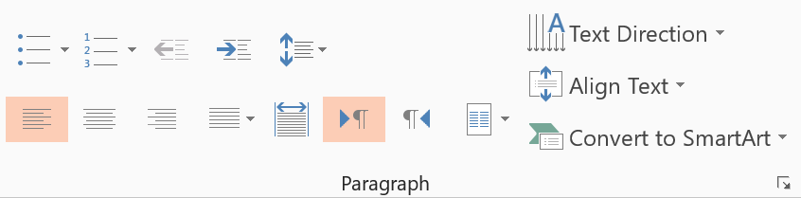
Notes to the template Text levels – standard text slides
The standard text area has five predefined type levels.
You can move up or down the levels using the increase or decrease indent buttons in the home tab.
We recommend that you do not use the bullet button, as this does not apply the correct bullet formatting.
On standard text layouts the text uses the following levels:
Level one – Arial 14pt (Body text standard)
Level two – Arial Bold 18pt (Introduction)
Level three – Arial 20pt (Heading)
Level four – Arial 14pt (first level of bullets)
Level five – Arial 14pt (second level of bullets)
Decrease list level
Increase list level

Slide 32
Notes to the template Text levels – small text slides
On small text layouts the text uses the following levels:
Level one – Arial 14pt (Body text standard)
Level two – Arial Bold 18pt (Introduction)
Level three – Arial 20pt (Heading)
Level four – Arial 14pt (first level of bullets)
Level five – Arial 14pt (second level of bullets)

Slide 33
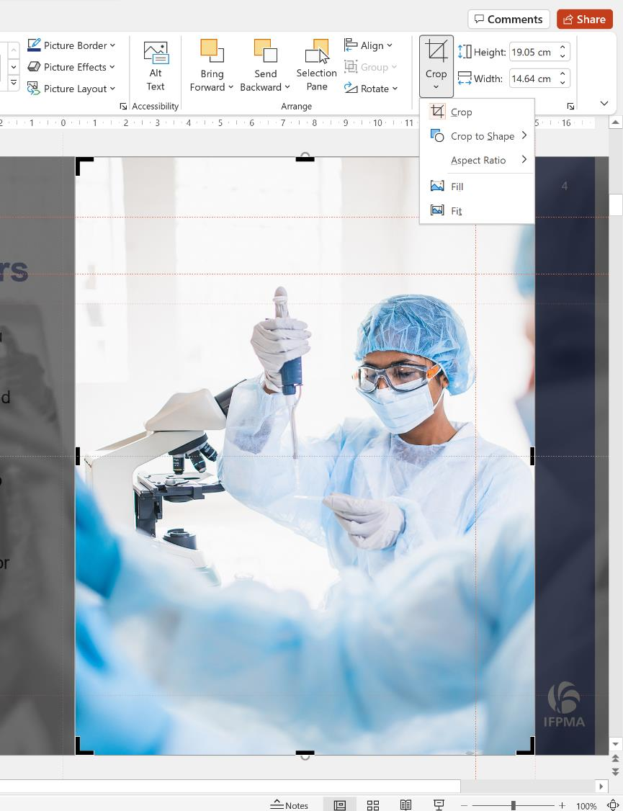
Notes to the template Using image placeholders
The picture slides are predefined with picture placeholders that help you to manage the image you add into the field.
Click the button in the middle of the field to select and import the picture you want to use. The picture field will automatically fill the field with the image.
You can edit the position of the image using the crop tool, which is in the ‘Picture Tools > Format menu. This menu appears when you click on an image.
The crop tool allows you to enlarge, adjust position or crop the image to fit.

Slide 34
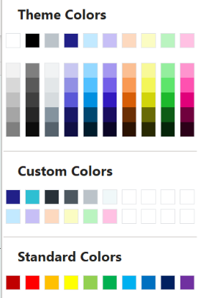
Notes to the template Tips and Recommendations
First hang line
Second hang line
Hang lines
The main body copy changes hang line depending on the length of the title. If the title first on one line, please make sure the text area is set to the top guide. If the title breaks over two lines, please use the second guide.
Title underline
Whether the title is over one or two lines, there should always be an underline below it. The easiest way to insert one is to copy it from an existing slide, as it will automatically be in the correct place when pasted.
Type levels and textboxes
Always use the type levels in the predefined content placeholders, supplied with each layout.
If you use text boxes, please note that they do not include the type levels. Any formatting has to be manually applied, and we recommend you adhere to the brand rules.
Colour palette
Always select a colour from the supplied colours.
The top row of the colour theme is the main brand colours that Office uses. Office automatically generates a set of tint values from the main colours, which can be used to manually assign to shapes and slide assets.
All of the brand colours are available in the Custom Colors section underneath. These have been named after their HEX values.
The standard colours row is supplied by Office and should not be used. Please do not manually apply colours using RGB values.

Slide 35
Notes to the template Colour palette & hierarchy
Primary
#212088 R33 G32 B136 |  | #2EBFD2 R46 G191 B210 |  | #293239 R41 G50 B57 |  | #4D5860 R77 G88 B96 |  | #BBC3C9 R187 G195 B201 |  | #F0F8F9 R240 G248 B249
Secondary
#C2E9FF R194 G233 B255 |  | #BAF4C0 R186 G244 B192 |  | #FBFCC3 R251 G252 B195 |  | #FDD9BF R253 G217 B191 |  | #FFC1E3 R255 G193 B227 |  | #C7BFF6 R199 G191 B246

